Slide 1
Live Session 5 DS6306
Ben Goodwin

Slide 2
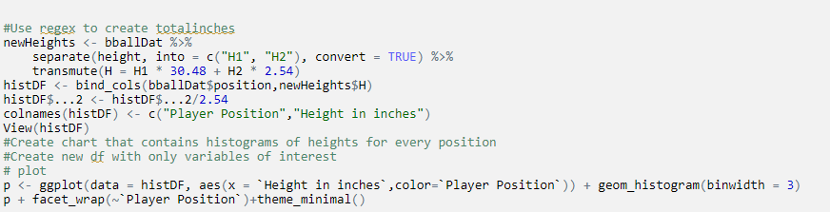
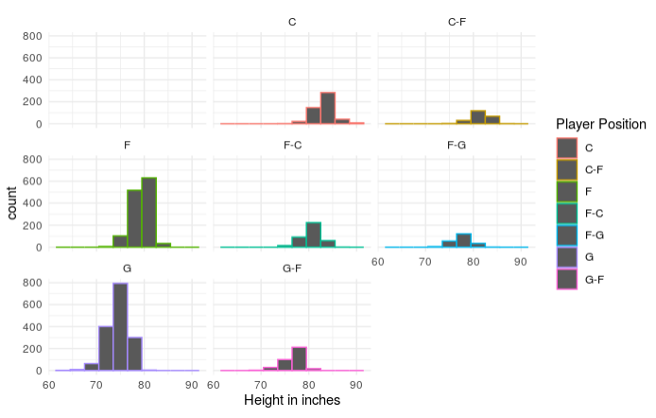
Basketball Study
R input for Part 1 and 2 (Regex and Histograms)

Slide 3
Basketball Study
Histogram of Player Position and Height (inches)

Slide 4
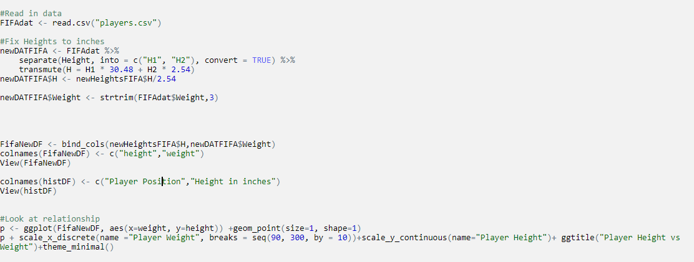
FIFA Questions
R input for Part 1 and 2 (Regex and Plot)

Slide 5
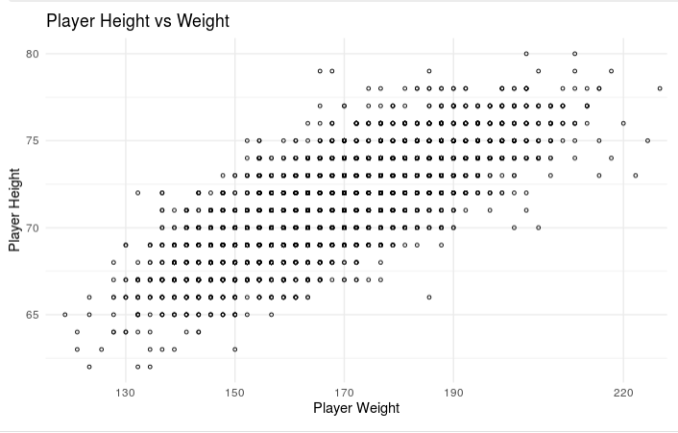
FIFA Questions
R out for Part 2 (Plot)

Slide 6
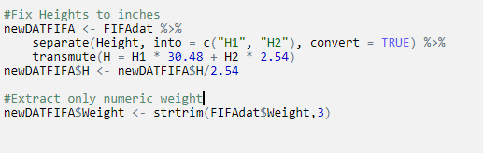
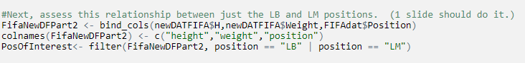
FIFA Questions
Relationship Between LB and LM
Plot input to study relationship (R)

Slide 7
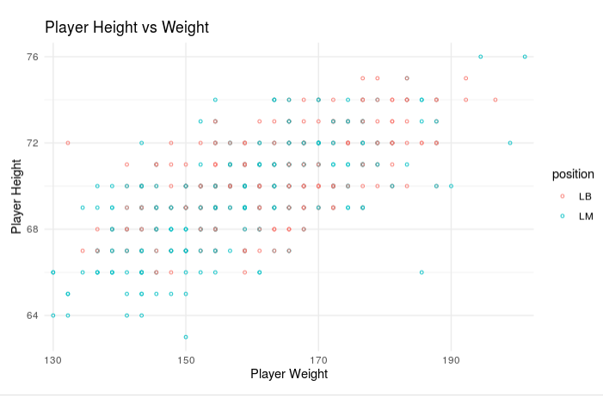
FIFA Questions
Player Height VS Weight (Position as color)

Slide 8
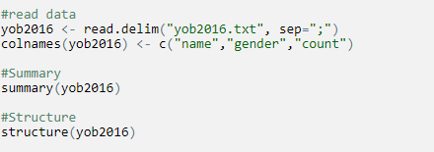
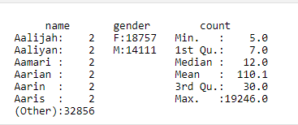
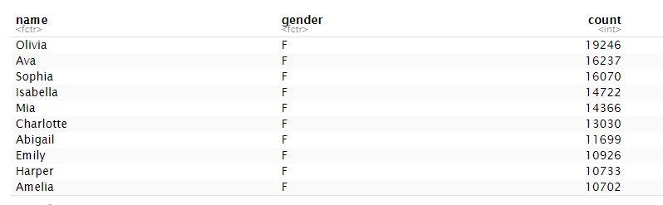
Baby Name Questions
Read in semicolon delimited data
Summary of data
Structure of data

Slide 9
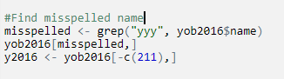
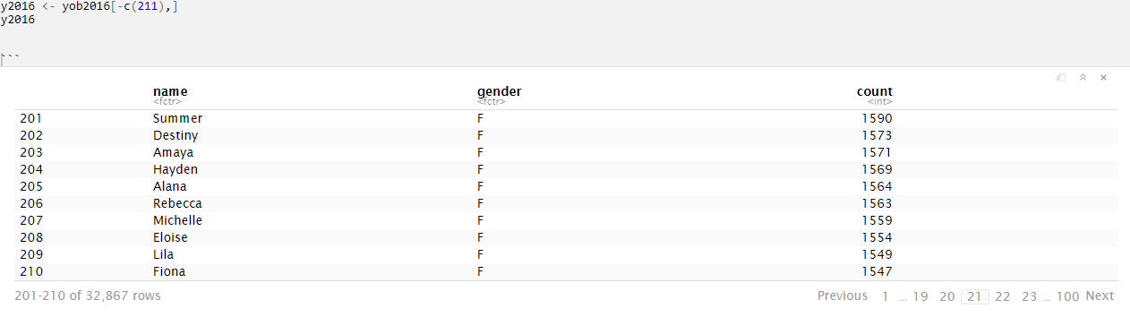
Baby Name questions
R input to find and remove misspelled name
R output for misspelled name
R input and output for new df without “fionayy”

Slide 10
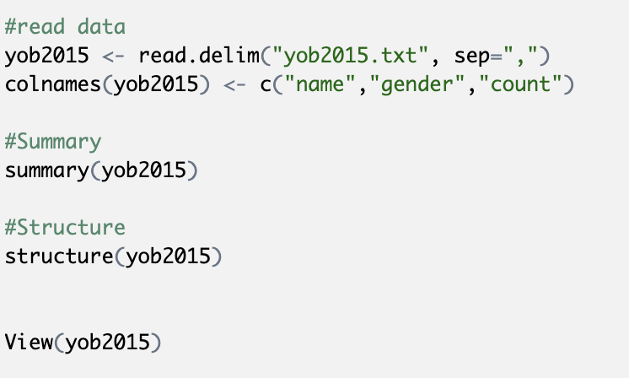
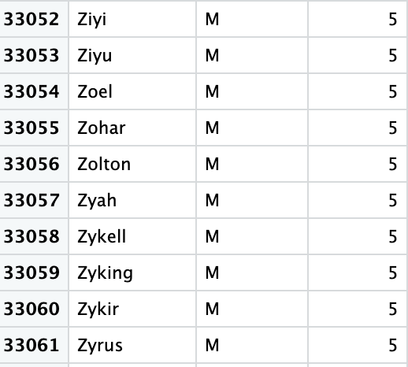
Baby Name Questions
R Input
Last ten names

Slide 11
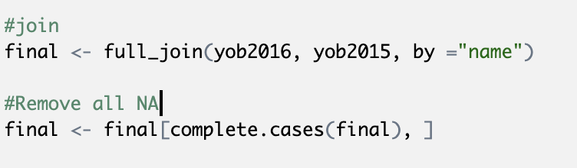
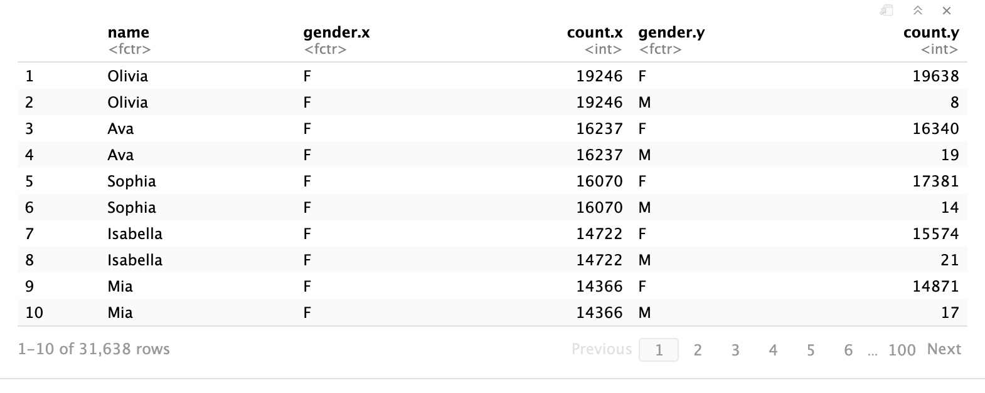
Baby Name Questions
R input: Merge tables, and remove all NA
Final Table:

Slide 12
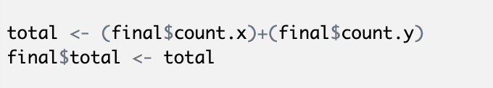
Baby Name Questions
R input:
Most popular names
Olivia
Noah
Liam
Sophia
Ava
Mason
William
Jacob
Isabella
James

Slide 13
Baby Name Questions
Most girl names
Olivia
Sophia
Ava
Isabella
Mia
Charlotte
Abigail
Emily
Harper
Amelia

Slide 14
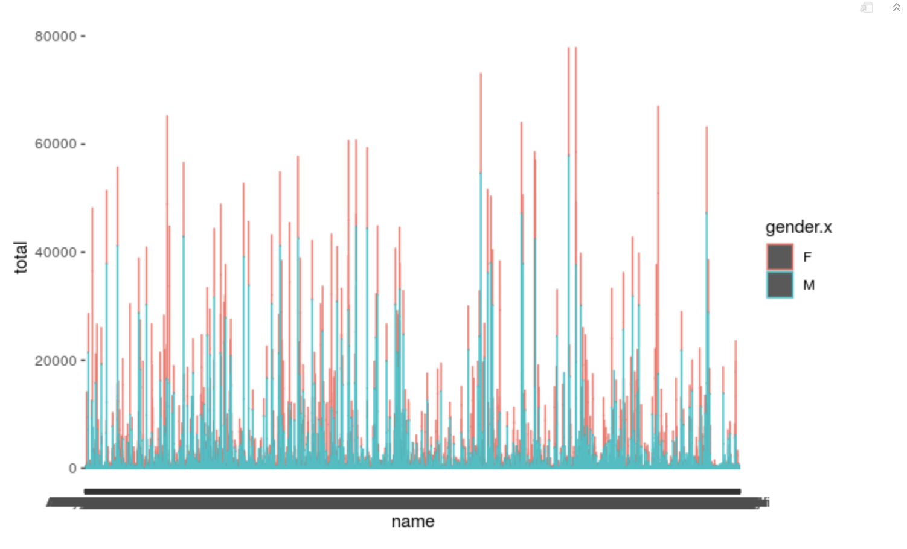
Baby Name Questions

Slide 15
Takeaways!
I really enjoyed this unit, and I felt confident for the most part.
Regular expressions are something I’ve struggled with in the past, so it was good to refresh on these.

